Slide 1
Updates and Reminders
Quiz: Chapters 5, 7-9 on Monday
content from the chapters
content from the lectures
content from the primary research workshop
Study Sessions Sun 1-3 (GH), Mon 10-12 (SL)
HW #4 Due by 2pm on TUESDAY (after the quiz)

Slide 2
Lecture 11 Objectives
Appreciate the crosstalk between the p53 and pRB pathways
Be able to describe 2 (or more) ways in which redundancy is built into cell cycle control to limit tumorigenic potential
Apply understanding of p53 regulation to interpret data figures from research article

Slide 3
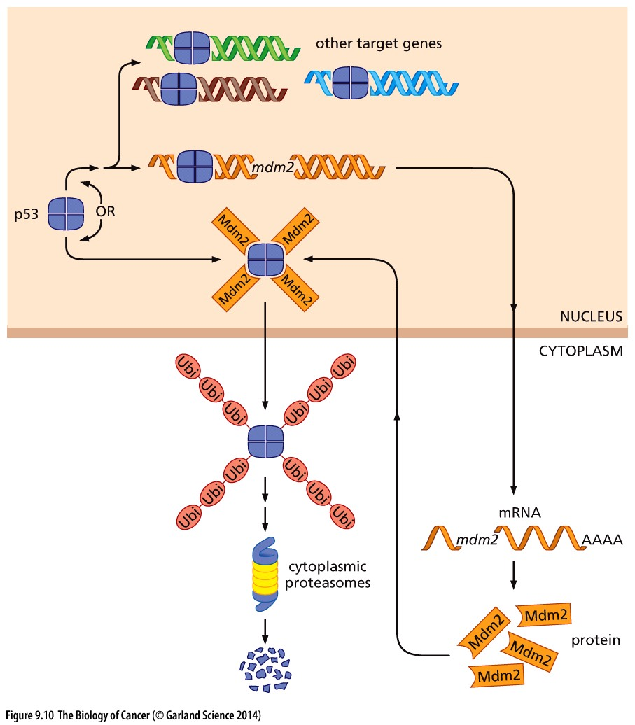
Mdm2 keep p53 levels low
p53 is a transcriptional regulator → promotes expression of MDM2
MDM2 is as ubiquitin ligase → places ubiquitin ‘tags’ on p53 to mark it for degradation
Cancers can co-opt this process & overexpress MDM2
Onocgenic MDM2 keeps p53 levels low and prevents cell cycle arrest

Slide 4
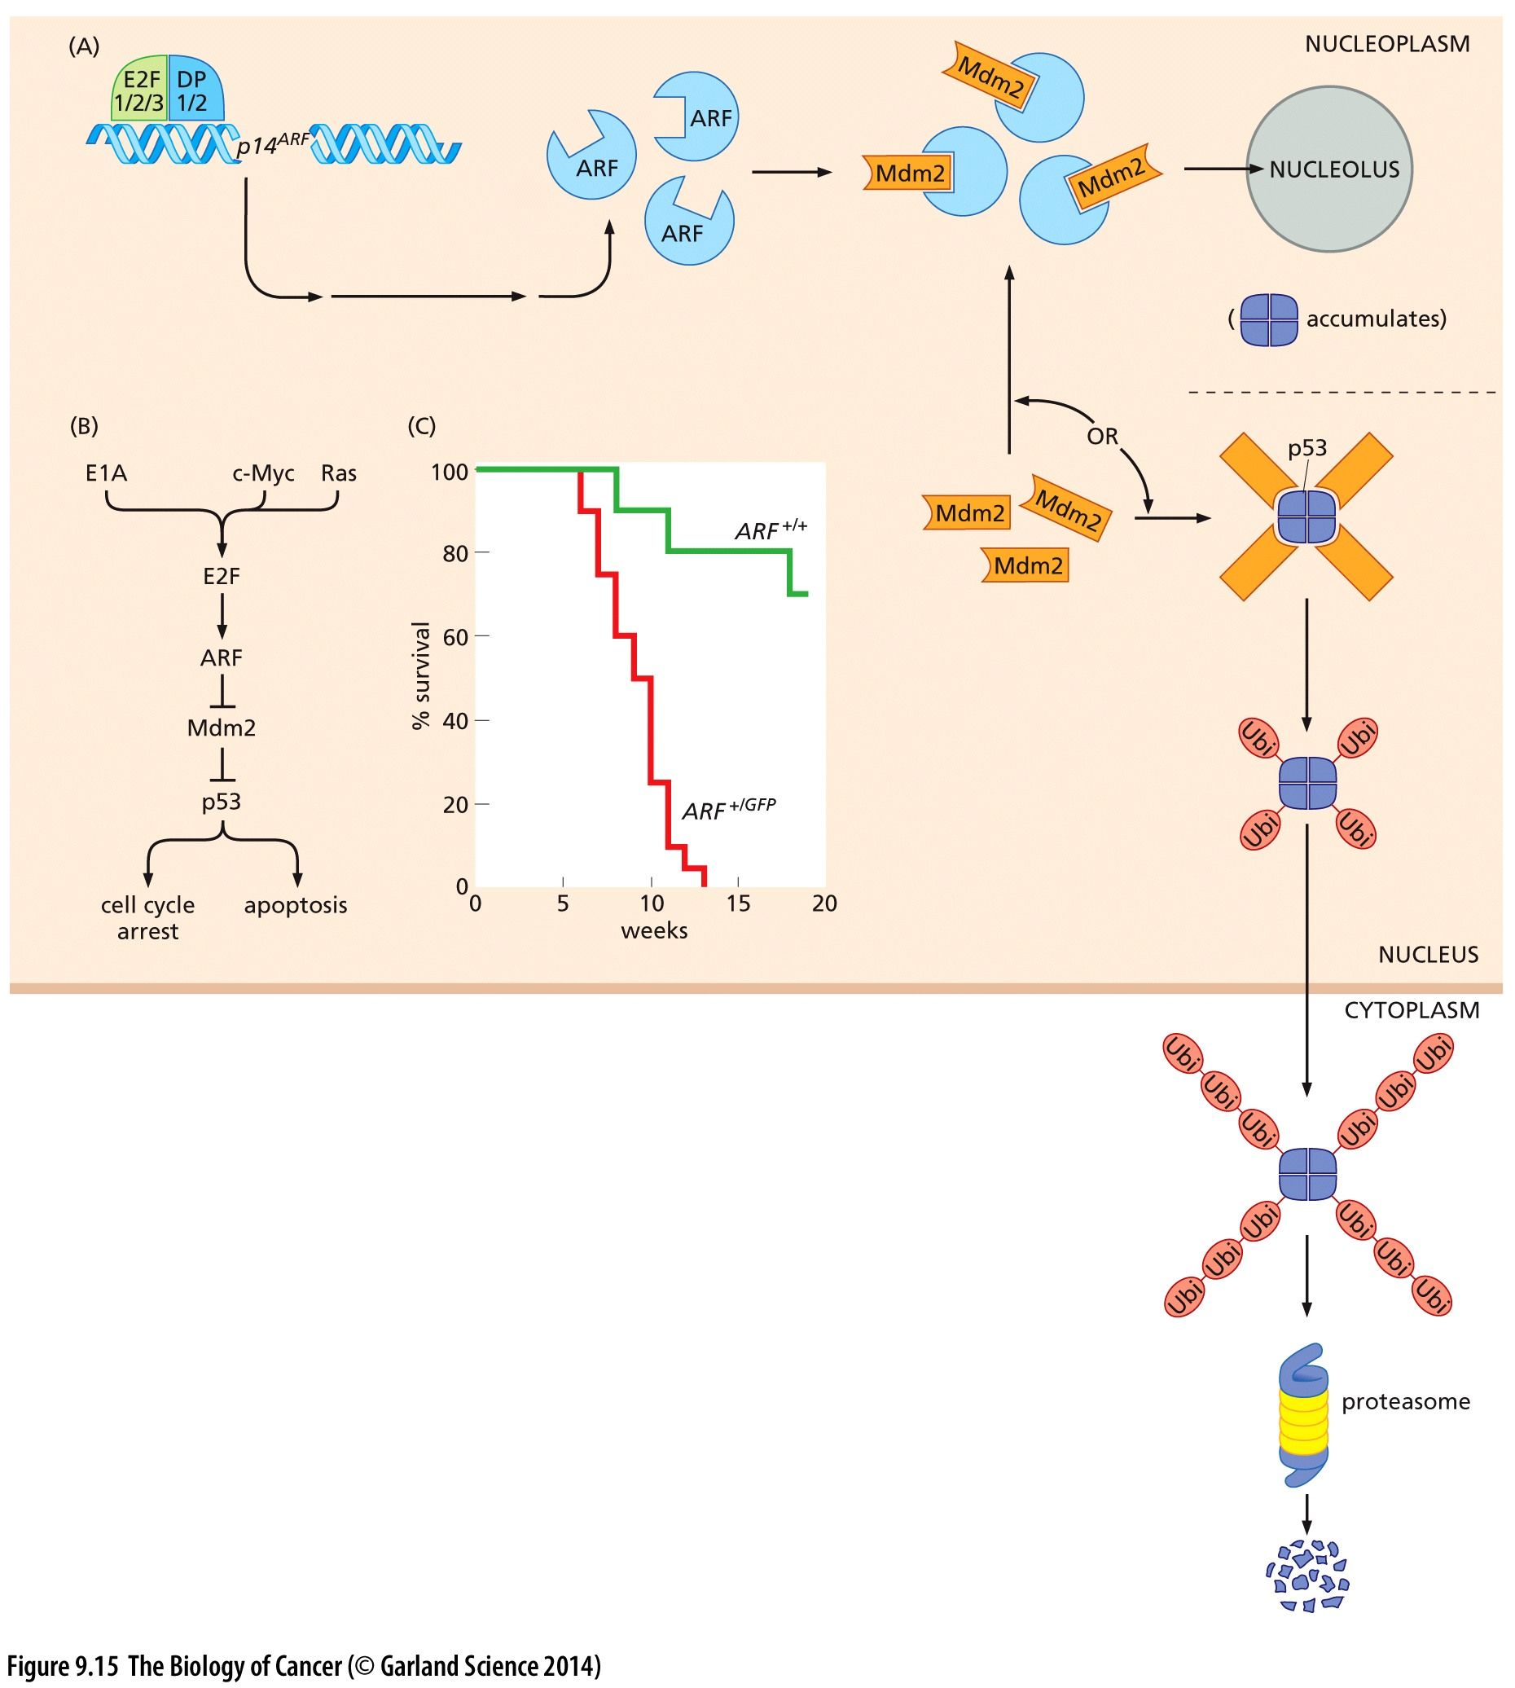
Who keeps tabs on Mdm2?
High p53 levels → Mdm2 expression
To sustain p53 dependent response (until damage is corrected), degradation of p53 by Mdm2 must be limited
How? ‘Turn off’ Mdm2 activity!
p14ARF is a negative regulator of Mdm2
Binds and sequesters Mdm2 so it can’t degrade p53

Slide 5
p14ARF is a tumor suppressor
p14ARF –I Mdm2 –I p53
Loss of p14ARF frees Mdm2 to promote p53 degradation
In a tumor prone animal model, loss of p14ARF allows cancer to progress faster
Animals succumb to their cancer sooner

Slide 6
p53 as a ’Gatekeeper’
p14ARF is an E2F transcriptional target
What happens if pRB tumor suppressor function is lost?
pRB —I E2F →p14ARF –I Mdm2 –I p53 –I cell cycle progression
Loss of pRB = more E2F activity
= more p14ARF protein
= less Mdm2 activity
= more p53 protein → cell cycle arrest
Safeguard to prevent cancer resulting from pRB loss

Slide 7
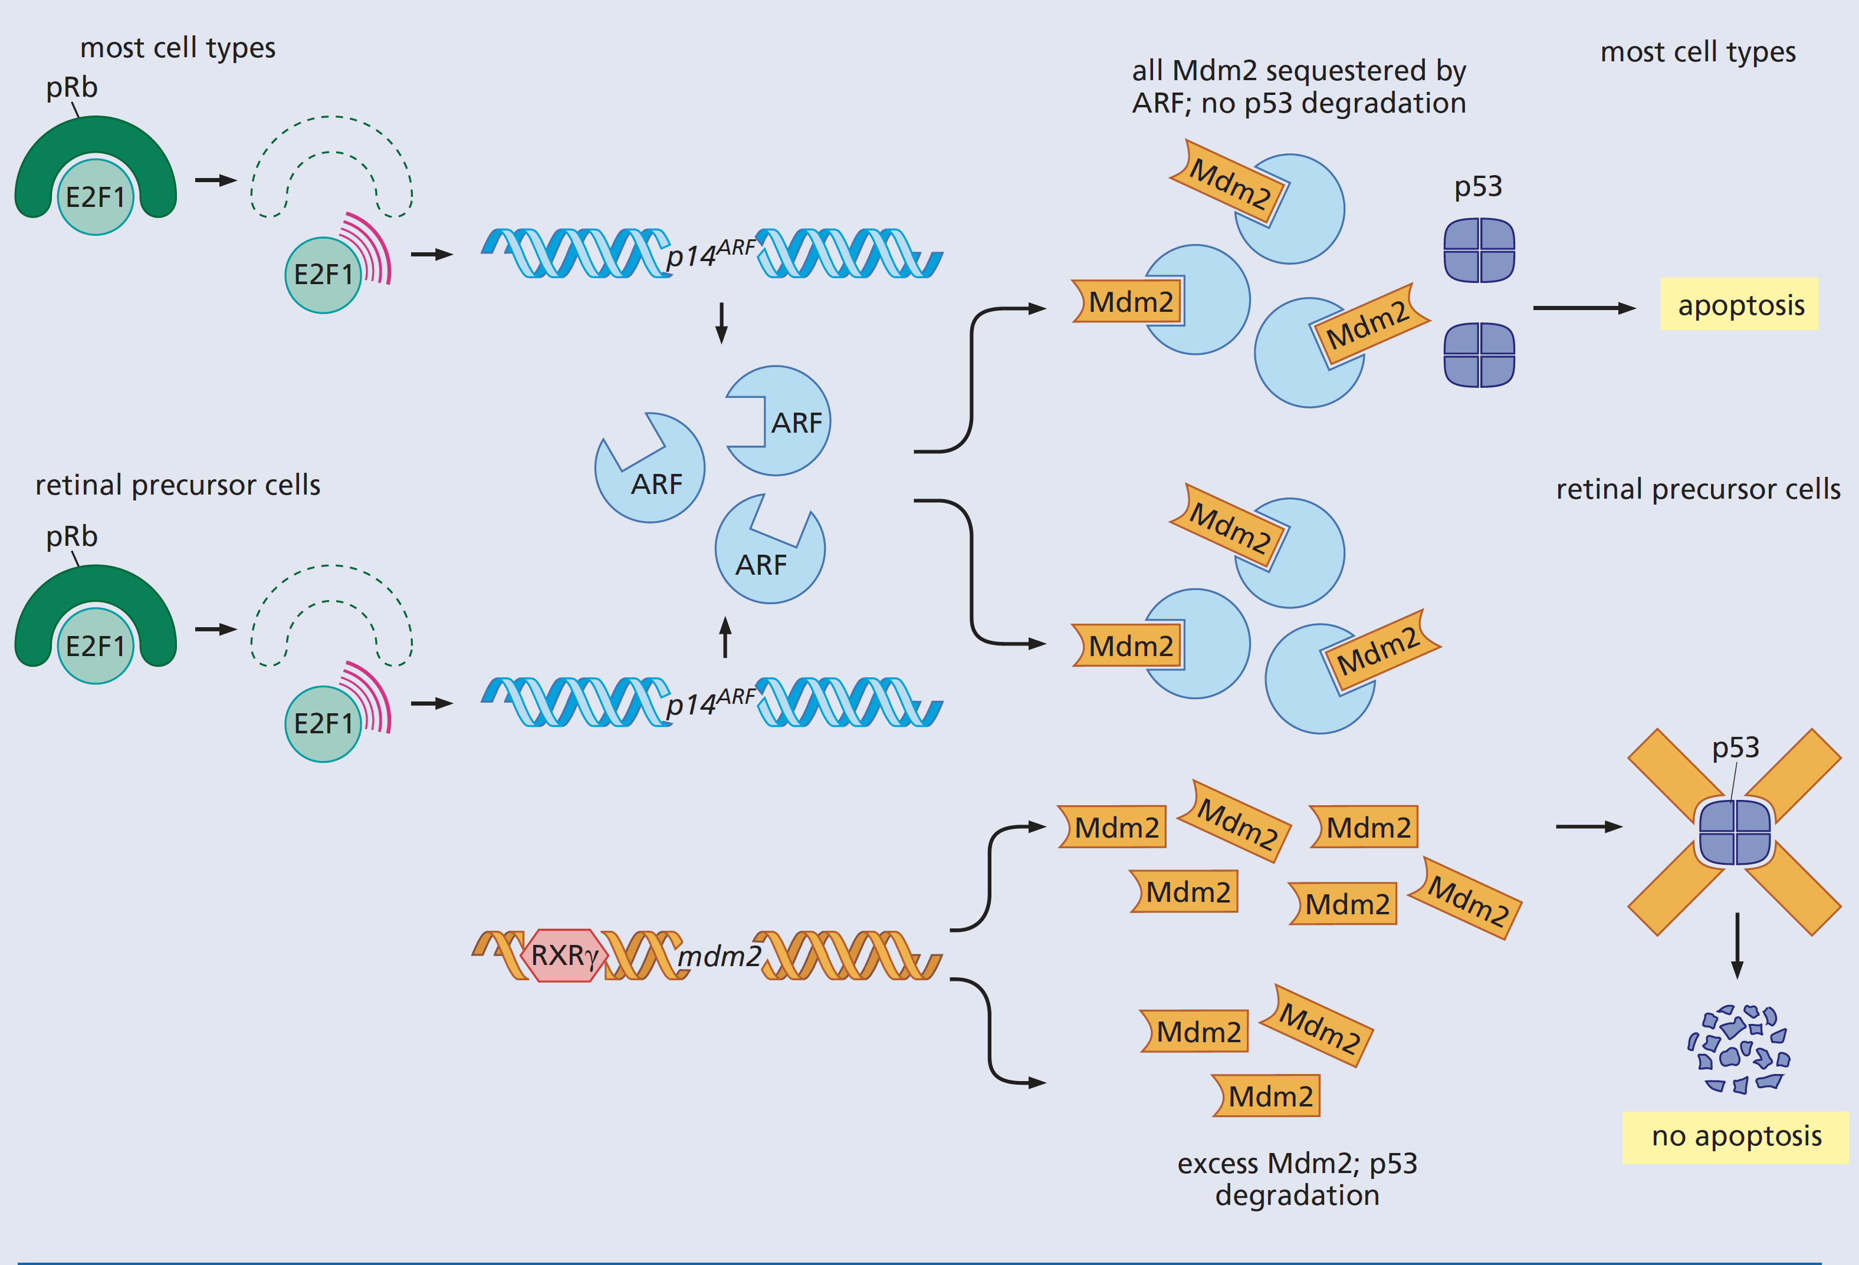
p53 as a ‘Gatekeeper’
P53 is a transcriptional regulator
Sustained high levels of p53 promotes multi-pronged activation of apoptotic pathways by increasing expression of:
FAS (‘death receptor’ protein)
IGF-binding protein (binds and sequesters extracellular insulin-like growth factor: IGF)
Proapoptotic factors Bax and FOXO3, etc

Slide 8
p53 as a ‘Gatekeeper’
How does pRB loss EVER cause cancer??
Retinoblastoma
Osteosarcoma
Non small cell lung cancer

Slide 9
Low p53 levels permit retinoblastoma
Retinal cells naturally express high levels of Mdm2
Overwhelms p14ARF levels and p53 is degraded

Slide 10
Loss of p53 function is rate limiting in other cancers
p53 loss of function mutations are rate limiting for osteosarcomas
p14ARF inactivation is widespread in NSCLC

Slide 11
Applying what you know
In Buntz et al. paper: “Requirement for p53 and p21 to sustain G2 arrest after DNA damage”
p53 and p21 are shown to be required for the G2 DNA damage checkpoint
In G1:
DNA damage → p53 stabilization → p21 transcription –I CyclinD/CDK –I pRB –I E2F →S
In G2:
DNA damage → p53 stabilization → p21 transcription –I CyclinB/CDK → mitosis
Loss of p53 or p21 corrupts BOTH the G1 and the G2 checkpoints

Slide 12
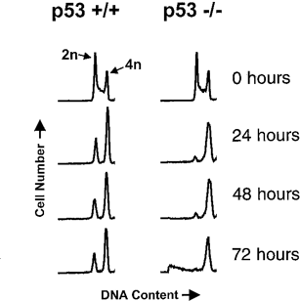
Assessing DNA content
Previous work suggested that “cells with disrupted p21 or p53 that are arrested in G2 can under-go DNA synthesis”
Does figure 2B from the Bunz et al paper support this conclusion?
Consider:
This assay measures the amount of DNA in individual cells
Cells in the 4N peak have twice as much DNA compared to the cells represented by the 2N peak
The timepoints represent the time that has passed since cells were exposed to DNA damaging radiation
Where would you expect cells in G1 to be?
Where would you expect cells in G2 to be?

Slide 13
Assessing DNA content
Previous work suggested that “cells with disrupted p21 or p53 that are arrested in G2 can under-go DNA synthesis”
Does figure 2B from the Bunz et al paper support this conclusion?
In the absence of damage, do the DNA profiles for cells without p53 look different then those with p53?
What about after DNA damage?
Based on this experiment alone, what do we know about cells with damage and without p53?
Following damage, p53 -/- cells have an increase in DNA content, consistent with what you would expect from cells that arrest in G2

Slide 14
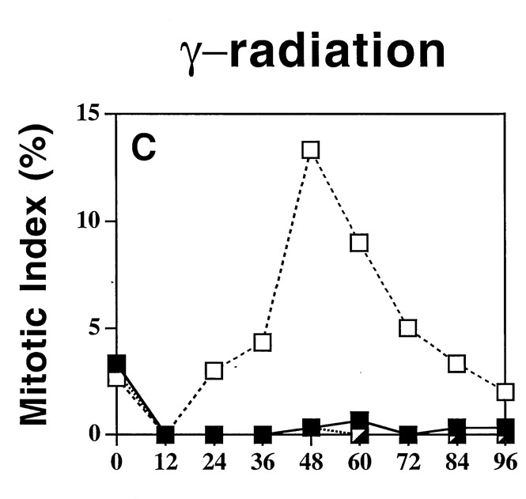
Assessing Cell Cycle Distribution
Previous work suggested that “cells with disrupted p21 or p53 that are arrested in G2 can under-go DNA synthesis”
Hypothesis: Cells without p53 arrest in G2 with 4N DNA content (ie can not progress to mitosis/completion of cell division)
Limitation of experiment in Figure 2B: Measures DNA content, NOT cell cycle arrest.
New approach in 2C: use imaging-based analysis to determine if cells can go into mitosis
How do p53-/- cells (empty boxes) behave differently then p53 +/+ or p53 +/- cells in this assay?
Do p53-/- cells enter mitosis and STAY in mitosis?
In p53-/- DNA content does NOT = Cell cycle stage

Slide 15
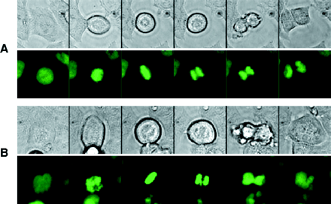
Following the data…
Previous work suggested that “cells with disrupted p21 or p53 that are arrested in G2 can under-go DNA synthesis”
Cells that progress to mitosis should reduce their DNA content by ½.
Hypothesis: If damaged p53-/- cells progress to mitosis but remain 4N, they must fail to complete cell division
Assay: Make movies to watch cells go through mitosis
histones are labeled with a green fluorophore so chromosomes can be visualized
How is mitotic fate different in damaged p53 -/- cells?
What do you think mitosis would look like in undamaged p53 -/- cells?

Slide 16
Revised interpretations
Previous work suggested that “cells with disrupted p21 or p53 that are arrested in G2 can under-go DNA synthesis”
Damaged cells lacking p53 have increased DNA content
Damaged cells lacking p53 do NOT arrest in G2 (interpretations of earlier studies were wrong)
Damaged cells lacking p53 continue through the cell cycle → mitosis
Cells maintain 4N DNA because cell division fails and all the DNA remains in one cell
Why is this important to know?

Slide 17
Applying what we’ve learned
Vincristine is a drug used in chemotherapy to treat cancer. It functions similarly to nocodazole. Why do you think this could be an effective cancer treatment?
If cells are kept in mitosis indefinitely, many will die
Most of the cells that make up our tissues are differentiated/post-mitotic (they don’t go through the cell cycle and divide anymore)
We now know that p53-/- cells continue through the cell cycle, even when damaged
should remain sensitive to drugs that target mitosis (like vincristine)
What other drugs/cellular assaults might be good therapeutics in p53-/- cancer cells?

Slide 18
Reminders: Features of a Primary Research Article
MUST (ALL of these)
Be peer reviewed (all articles on NCBI pubmed are peer reviewed)
Contain Materials and Methods describing how experiments were performed (may appear in the body of the paper or in supplemental data)
Present DATA (results of experimental approaches)
Tables and/or graphs
Western, northern, or southern blots
Microscopy, structural renderings
A paper with figures that are exclusively models or cartoons is unlikely to be a research article
Be the first time these specific experiments have been published
Clinical and bioinformatics studies may meet these criteria (and count towards your 4 required primary research articles) but on their own will not provide the functional detail you need to complete your essay and graphical representation of your cancer gene’s cellular function

